Slide 1

Auto Wash
MOhammed alharbi

Slide 2
Auto Wash
Auto Wash is a program that connects client users with owners of self-service laundry shops, whether for clothes or cars.
Shop owners can add their shops and list the services they offer, including service names, prices, and durations.
Users can search for nearby self-service laundry shops, browse their services, and place orders.

Slide 3
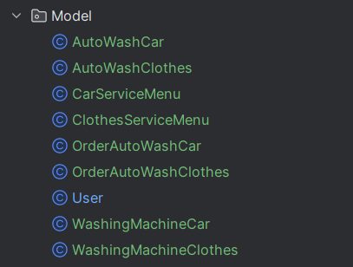
Models

Slide 4


User
CRUD
addBalance(Integer id, double amount)
transferBalance(Integer fromUserid,Integer toUserid, double amount)
giftBalanceFiveOrders(Integer userId)
String searchUser(Integer searchingUserId, Integer searchedUserId)
getCheapestPrice(Integer userId)
List <> nearBranch(String keyword)
List<> openAutoWashCar(Integer userId
userOrderAutoWashCarHistory(Integer userId)
orderCancellation(Integer userid, Integer orderID)
void validatePin(Integer washingMachineCarId, String pin)
addOrderAutoWash and generatePin

Slide 5
2. AutoWash(Car or Clothes)
CRUD
addAutoWashAutoWashCar and addWashingMachineByOrderCapacity at the same time
changeOpenOrClosed(Integer autoWashCarId)
addDiscount(Integer serviceId, Integer discount)

Slide 6
Thank you

